Slide 1
India Votes
Data Visualisation Project

Slide 2
Introduction
World’s largest democracy
Parliamentary General Elections reflect democratic principles and public sentiment.
Aim to visually interpret India’s electoral journey.

Slide 3
Plots Developed

Slide 4
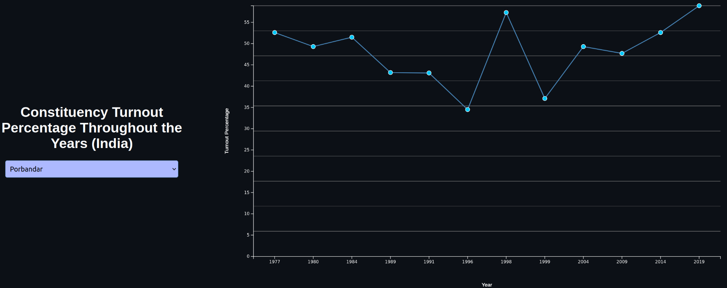
Year Wise Turnout Plot for Each Constituency

Slide 5
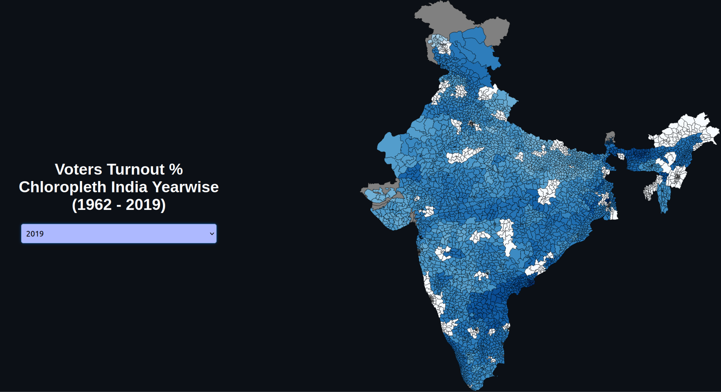
Turnout Chloropleth Map

Slide 6
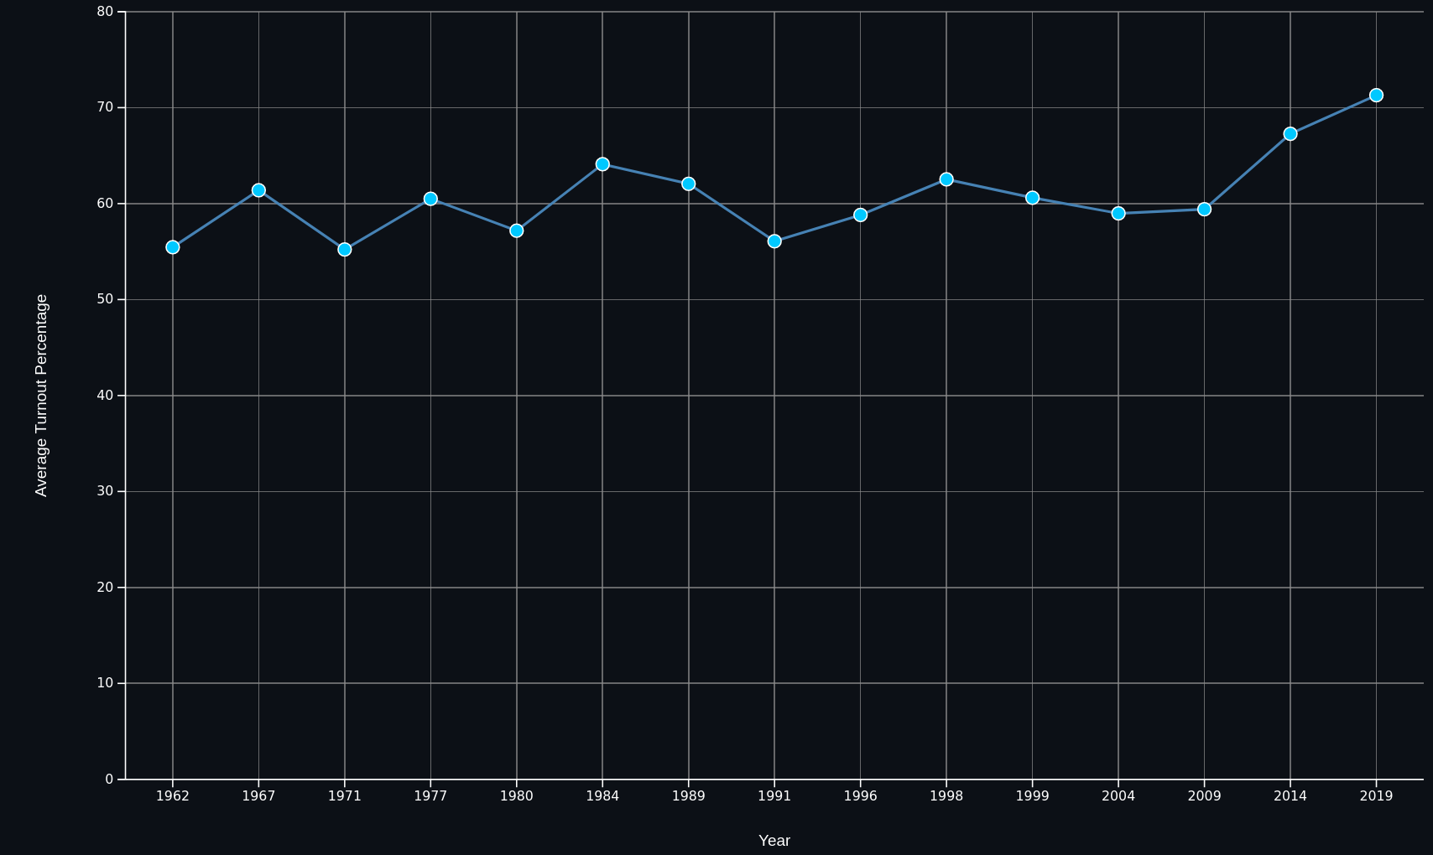
Average Turnout Percentage (1962-2019)

Slide 7
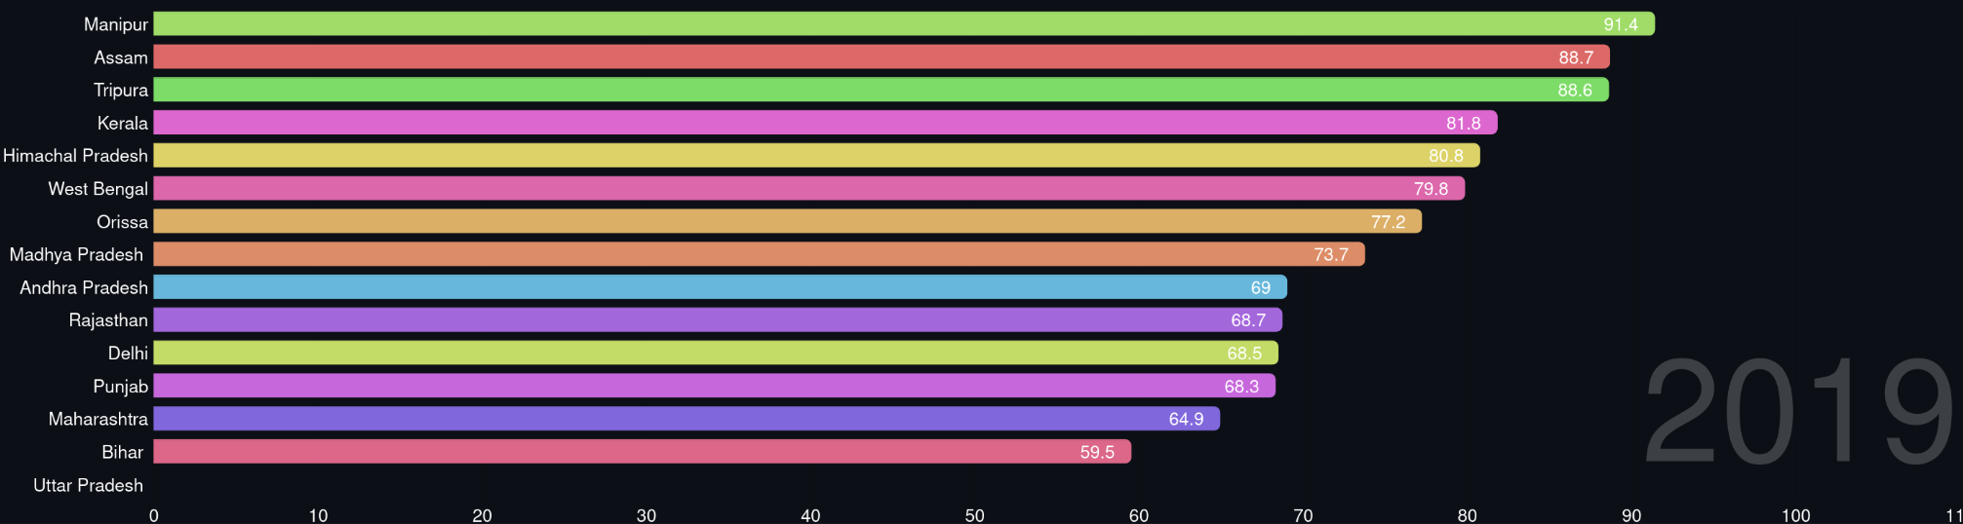
Turnout Race (Dynamic)

Slide 8
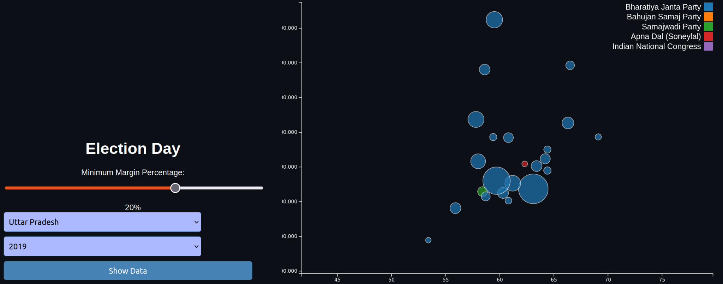
ScatterPlot for %Margin , %Turnout and Votes:

Slide 9
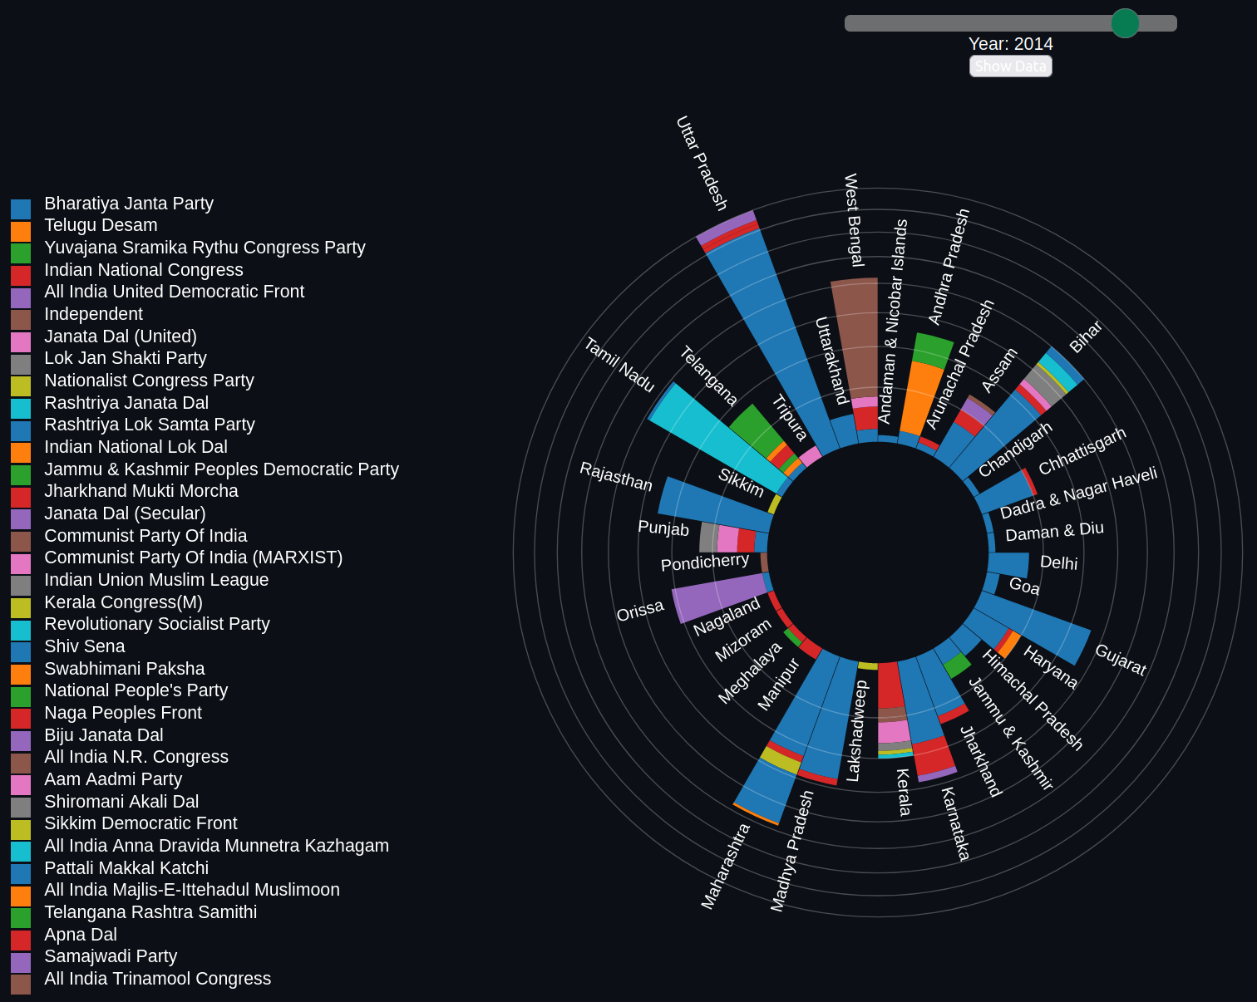
State Wise distribution of winning parties

Slide 10
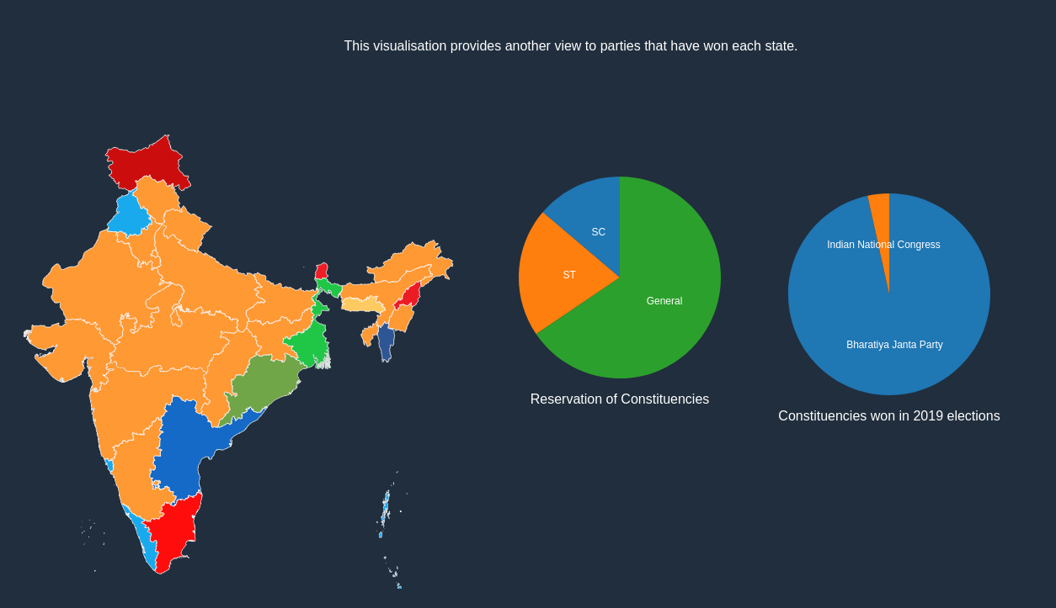
Statewide Winning Parties Chloropleth:

Slide 11
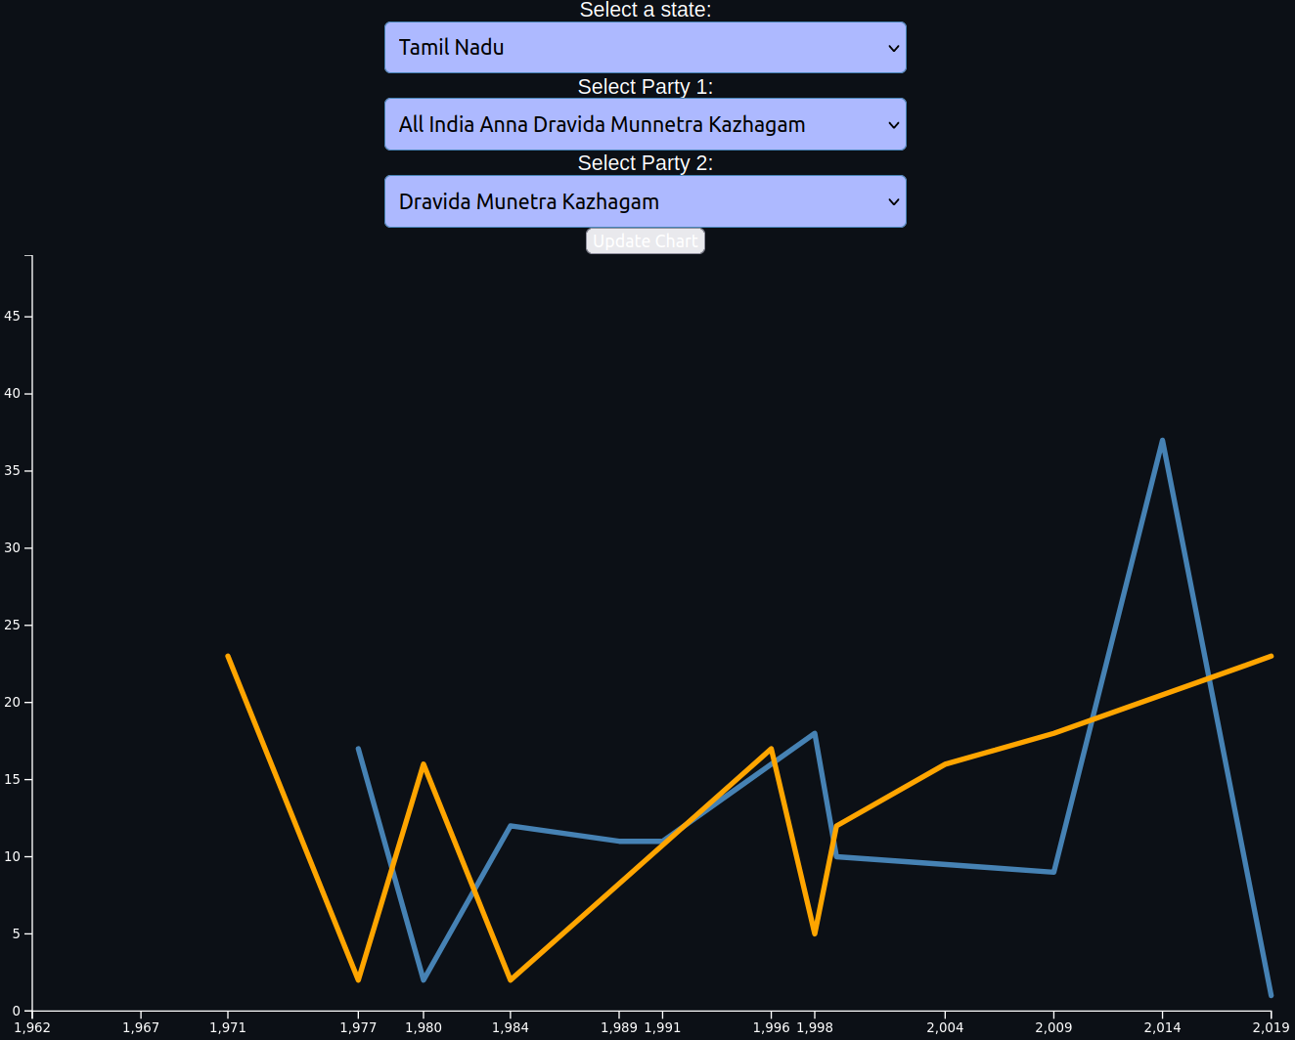
Comparison between two parties at a state level

Slide 12
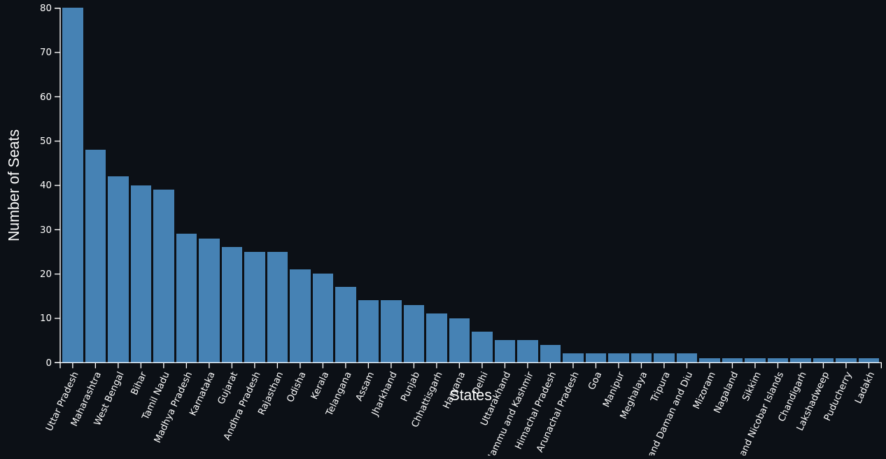
Distribution of seats among states

Slide 13
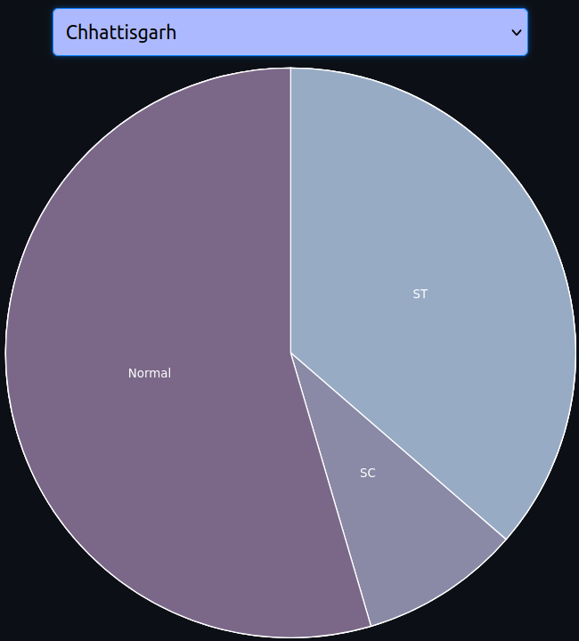
Seat Reservation Pie Chart

Slide 14
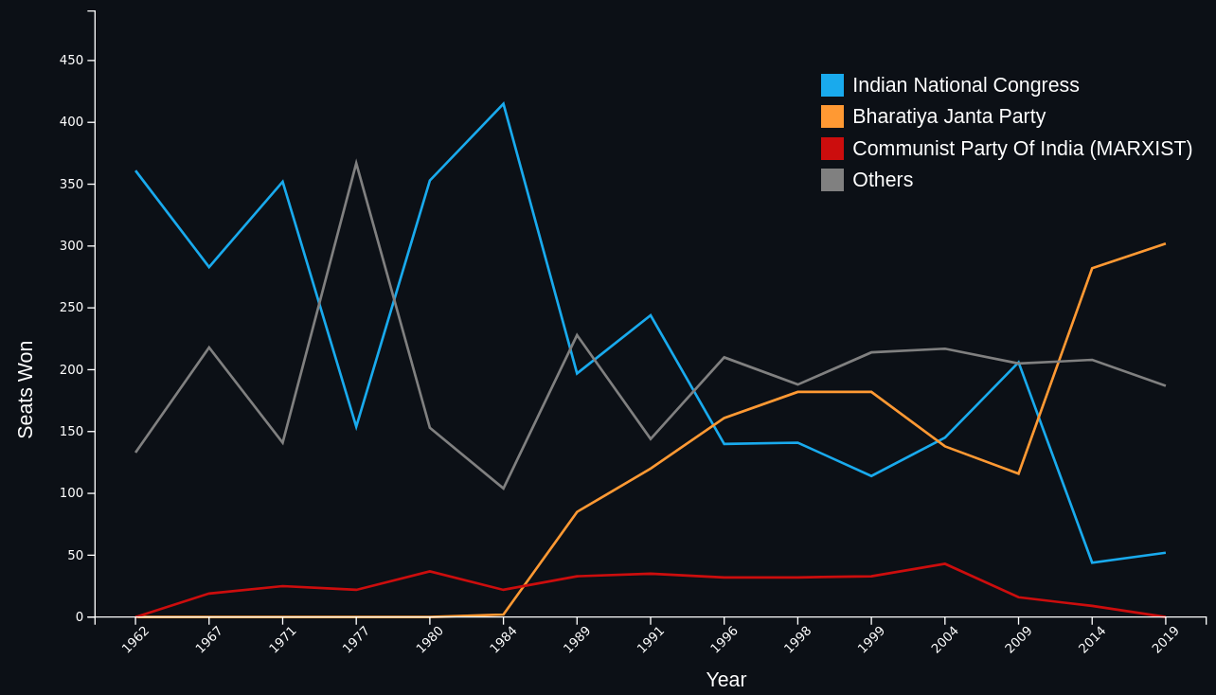
Evolution of Major Political Parties

Slide 15
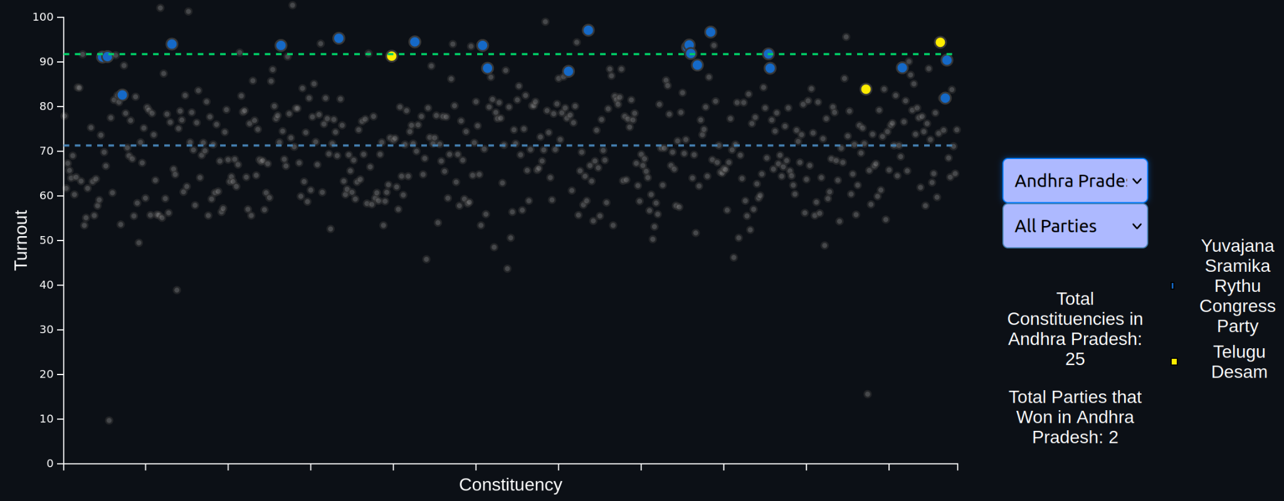
Constituency Turnout Scatter Plot

Slide 16
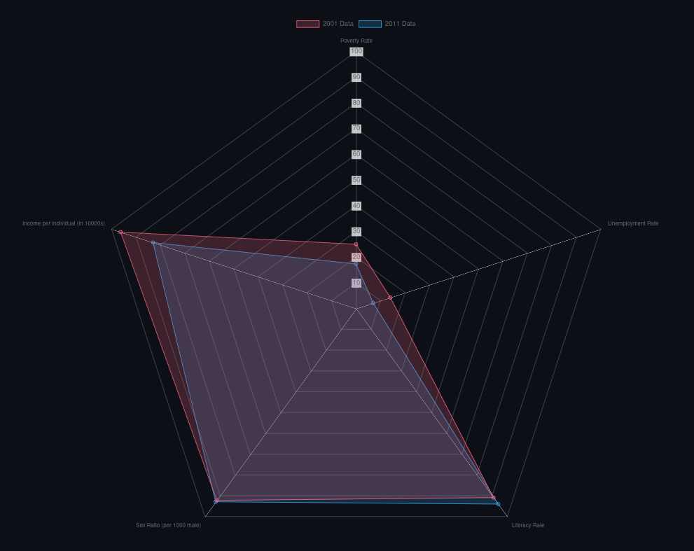
Various Metrics for Population Analysis

Slide 17
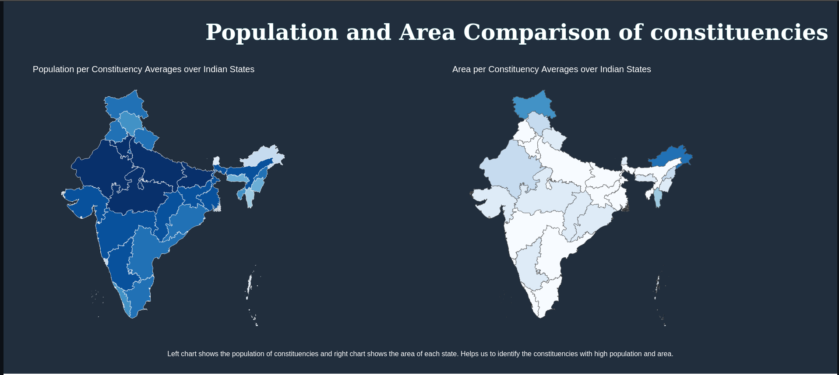
Population and Area Comparison of Constituencies

Slide 18
Benefits of Visualisations
Informing Voters
Guiding Upcoming Politicians
Assisting Political Parties
Enabling Insightful Coverage by Press
Supporting Political Analysts:

Slide 19
Team
2022101020 - Prithvi Karthik
2022101086 - Hemang Jain
2022101088 - Mohak Somani

